Slide 1
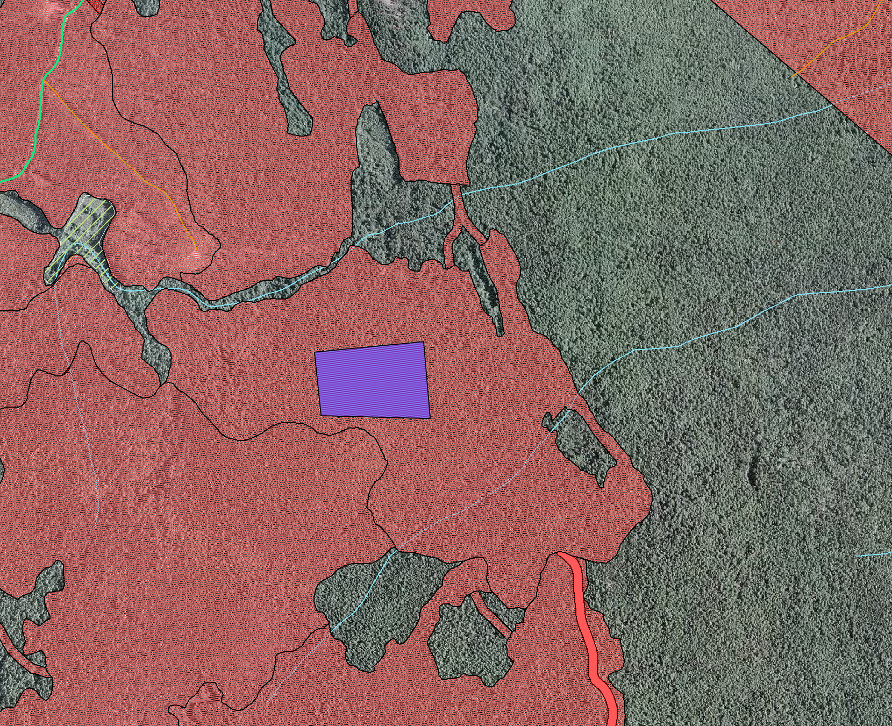
DEEP CREEK AMAT PLANTED 2009
Deep Creek EP 1392.04
Corner geographic coordinates
A: 50°33’34.9” N
119°16’51.0” W
B: 50°33’29.5” N
119°16’51.1” W
C: 50°33’30.4” N
119°17’ 3.2” W
D: 50°33’34.9” N
119°17’ 3.5” W
A
D
CP 2 Block 1
NRFL A80628
Mapsheet 82L.054
UTM Zone 11: 338450,
5603324
Contact: Jill Werk
Okanagan Shuswap Forest District 250-558-1782
Elev 1130 m
IDF mw1
C
B

